Slide 1
Hallmark Awards in Depth: Honors in Action
Michelle Coach – New England Regional Coordinator, Asnuntuck Community College, Enfield, CT
Leo Studach – Indiana Regional Coordinator, Ivy Tech Community College, Logansport, IN

Slide 2
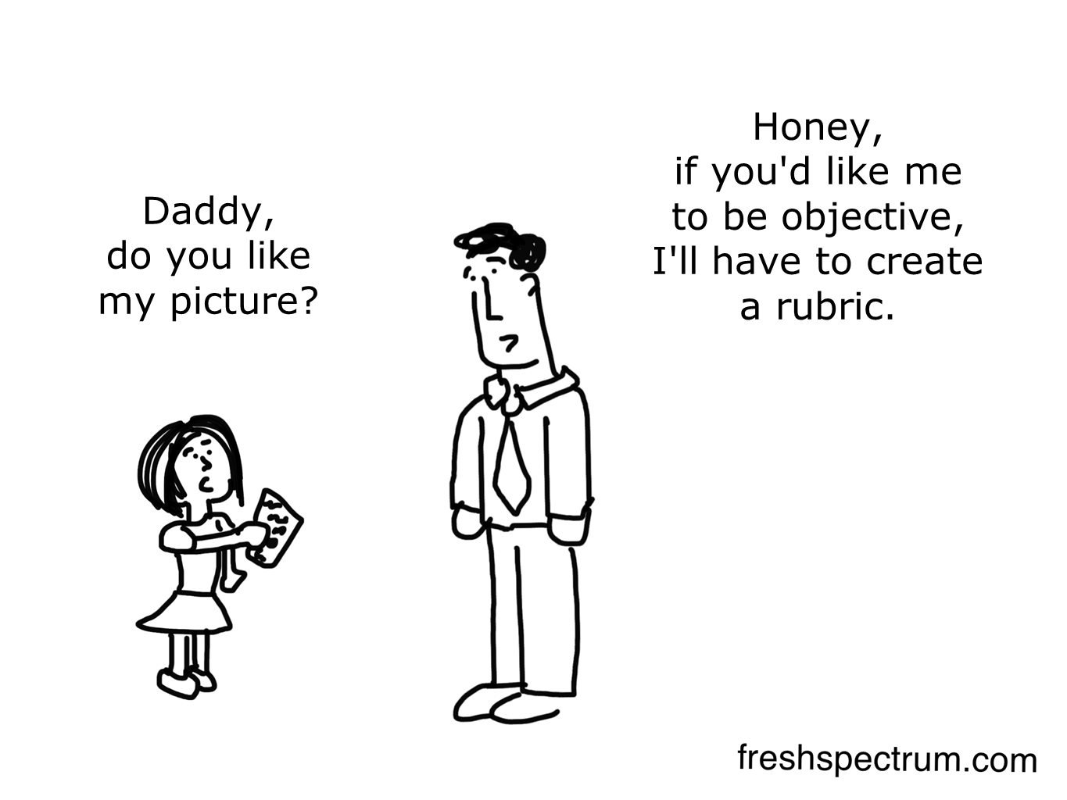
Hallmark Awards in Depth: Honors in Action

Slide 3
Getting Started: The Research Question
When proposing a research question make sure that it is congruent with the question in the Honors Program Guide.

Slide 4
What Makes A Good Source?

Slide 5
What Makes A Good Source???
Finch, W. Holmes and Mary Baker-Boudissa. Predictors of Student Mobility and Retention in Indiana Charter Schools. Published 2008.
This report from Ball State University demonstrated that charter schools in Indiana have a higher retention and graduation rate than their public school counterparts.
U.S. Department of Education. Highlights From PISA 2009.
A 2009 report of 15 year old students in reading, mathematics and science performance that demonstrates the United States ranks 17th overall.
Lumina Foundation. A Stronger Nation Through Higher Education: Indiana. 2012.
A report compiling U.S. census data about education rankings in Indiana. In the report, only 20.40% of Cass County adults have an associate’s degree. That puts Cass County in the bottom 15% of Indiana's 92 counties for degree attainment.

Slide 6
Organizing Sources
Use any type of referencing (APA, MLA, etc.) and be consistent
Use words carefully – they count towards your total
Should be academic resources
Varied resources of different aspects of topic
Make sure they are current info

Slide 7
What Makes A Good Source???
This report from Ball State University demonstrated that charter schools in Indiana have a higher retention and graduation rate than their public school counterparts.
Finch, W. Holmes and Mary Baker-Boudissa. Predictors of Student Mobility and Retention in Indiana Charter Schools. Published 2008.
U.S. Department of Education. Highlights From PISA 2009. A 2009 report of 15 year old students in reading, mathematics and science performance that demonstrates the United States ranks 17th overall.
Lumina Foundation. A Stronger Nation Through Higher Education: Indiana. 2012. A report compiling U.S. census data about education rankings in Indiana. In the report, only 20.40% of Cass County adults have an associate’s degree. That puts Cass County in the bottom 15% of Indiana's 92 counties for degree attainment.

Slide 8
What Makes A Good Source???
Finch, W. Holmes and Mary Baker-Boudissa. Predictors of Student Mobility and Retention in Indiana Charter Schools. Published 2008. This report from Ball State University demonstrated that charter schools in Indiana have a higher retention and graduation rate than their public school counterparts.
U.S. Department of Education. Highlights From PISA 2009. A 2009 report of 15 year old students in reading, mathematics and science performance that demonstrates the United States ranks 17th overall.
Lumina Foundation. A Stronger Nation Through Higher Education: Indiana. 2012. A report compiling U.S. census data about education rankings in Indiana. In the report, only 20.40% of Cass County adults have an associate’s degree. That puts Cass County in the bottom 15% of Indiana's 92 counties for degree attainment.

Slide 10
What is Resourcefulness?
How are you working effectively and creatively?
Note what challenges that you are encountering in the process of the project and how you are overcoming these challenges and obstacles= resourceful!
Works hand-in-hand with persistence but adds the resource aspect
If the project requires resources/equipment how did you acquire them?

Slide 12
How did you define Leadership Development and Leadership Activities?
Leadership development- What did you do to learn about something
Did you consult an expert or call in an expert?
Did you research the way to do something and the information taught you something?
Leadership activities- How did you display leadership in what was done
Did you take the lead on an aspect of the project?
Did you learn through leadership development and then train the rest of the group?

Slide 13
What is the key to persistence?

Slide 14
How can you show Persistence?
Did you project meet any obstacles that had to be overcome? If so, how did you overcome them?
Did you start with a specific project and then have to go a different route?
How did you overcome challenges that resulted in a project developed?

Slide 16
Is the Action congruent with the Research?
What could serve as action?
Did the action come out of the research?
This is the most important item that must occur
Did this action address the topic of Global issues?
Did the action involve the community?

Slide 18
Who was involved in the Action?
Who experienced the final project?
College, community, and beyond
You must include the communication aspect of the project
Who was involved in the project and who did you need to speak to
How did you get this communication completed?

Slide 20
Impacts
What impact did this project make?
On the community, college, students
Are there goals/ objectives not complete?
Document the qualitative and quantitative outcomes
Reflect personally on what gained and learned

Slide 21
Other Tips to Hallmark Success
What worked and what didn’t work?
Keep it focused on Honors Study Topic
Edit, edit, edit
Who should edit?
Have one writer, one voice, but all input
Keep your journal for the whole project

Slide 22
Chapter Hallmark Awards Deadline
Honors in Action Project Award – Due: January 25, 2017
College Project Award – Due: January 25, 2017

Slide 23
Other Hallmark Award Categories
College Administrator Awards – Due: December 7, 2016
Write this award now/soon!
Advisor Award(s) – Due: January 11, 2017
Chapter President must initiate this award
Requires talking with campus president/administrator and getting a letter of support. Start this one early!
Chapter Member Award – Due January 11, 2017
Chapter Officer/Chapter Officer Team – Due January 11, 2017

