Slide 1
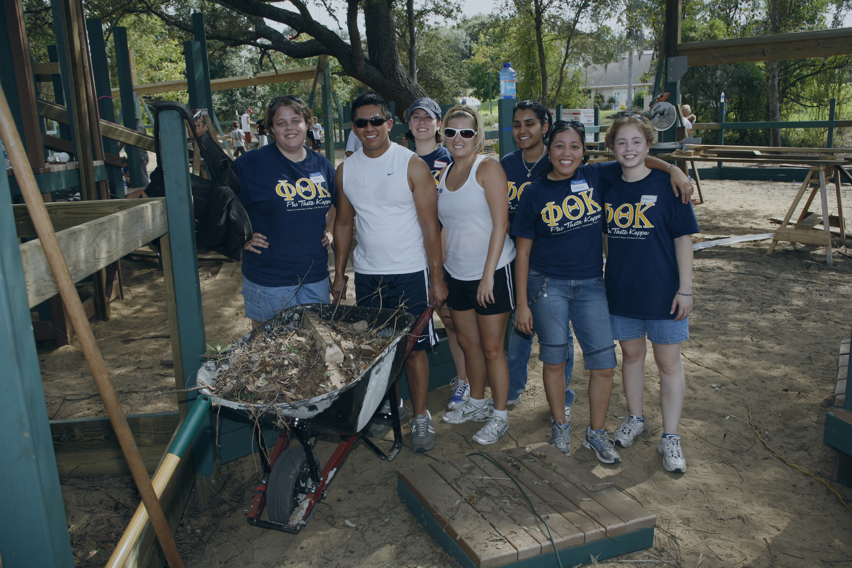
College Project:
A Chapter-College Partnership

Slide 2
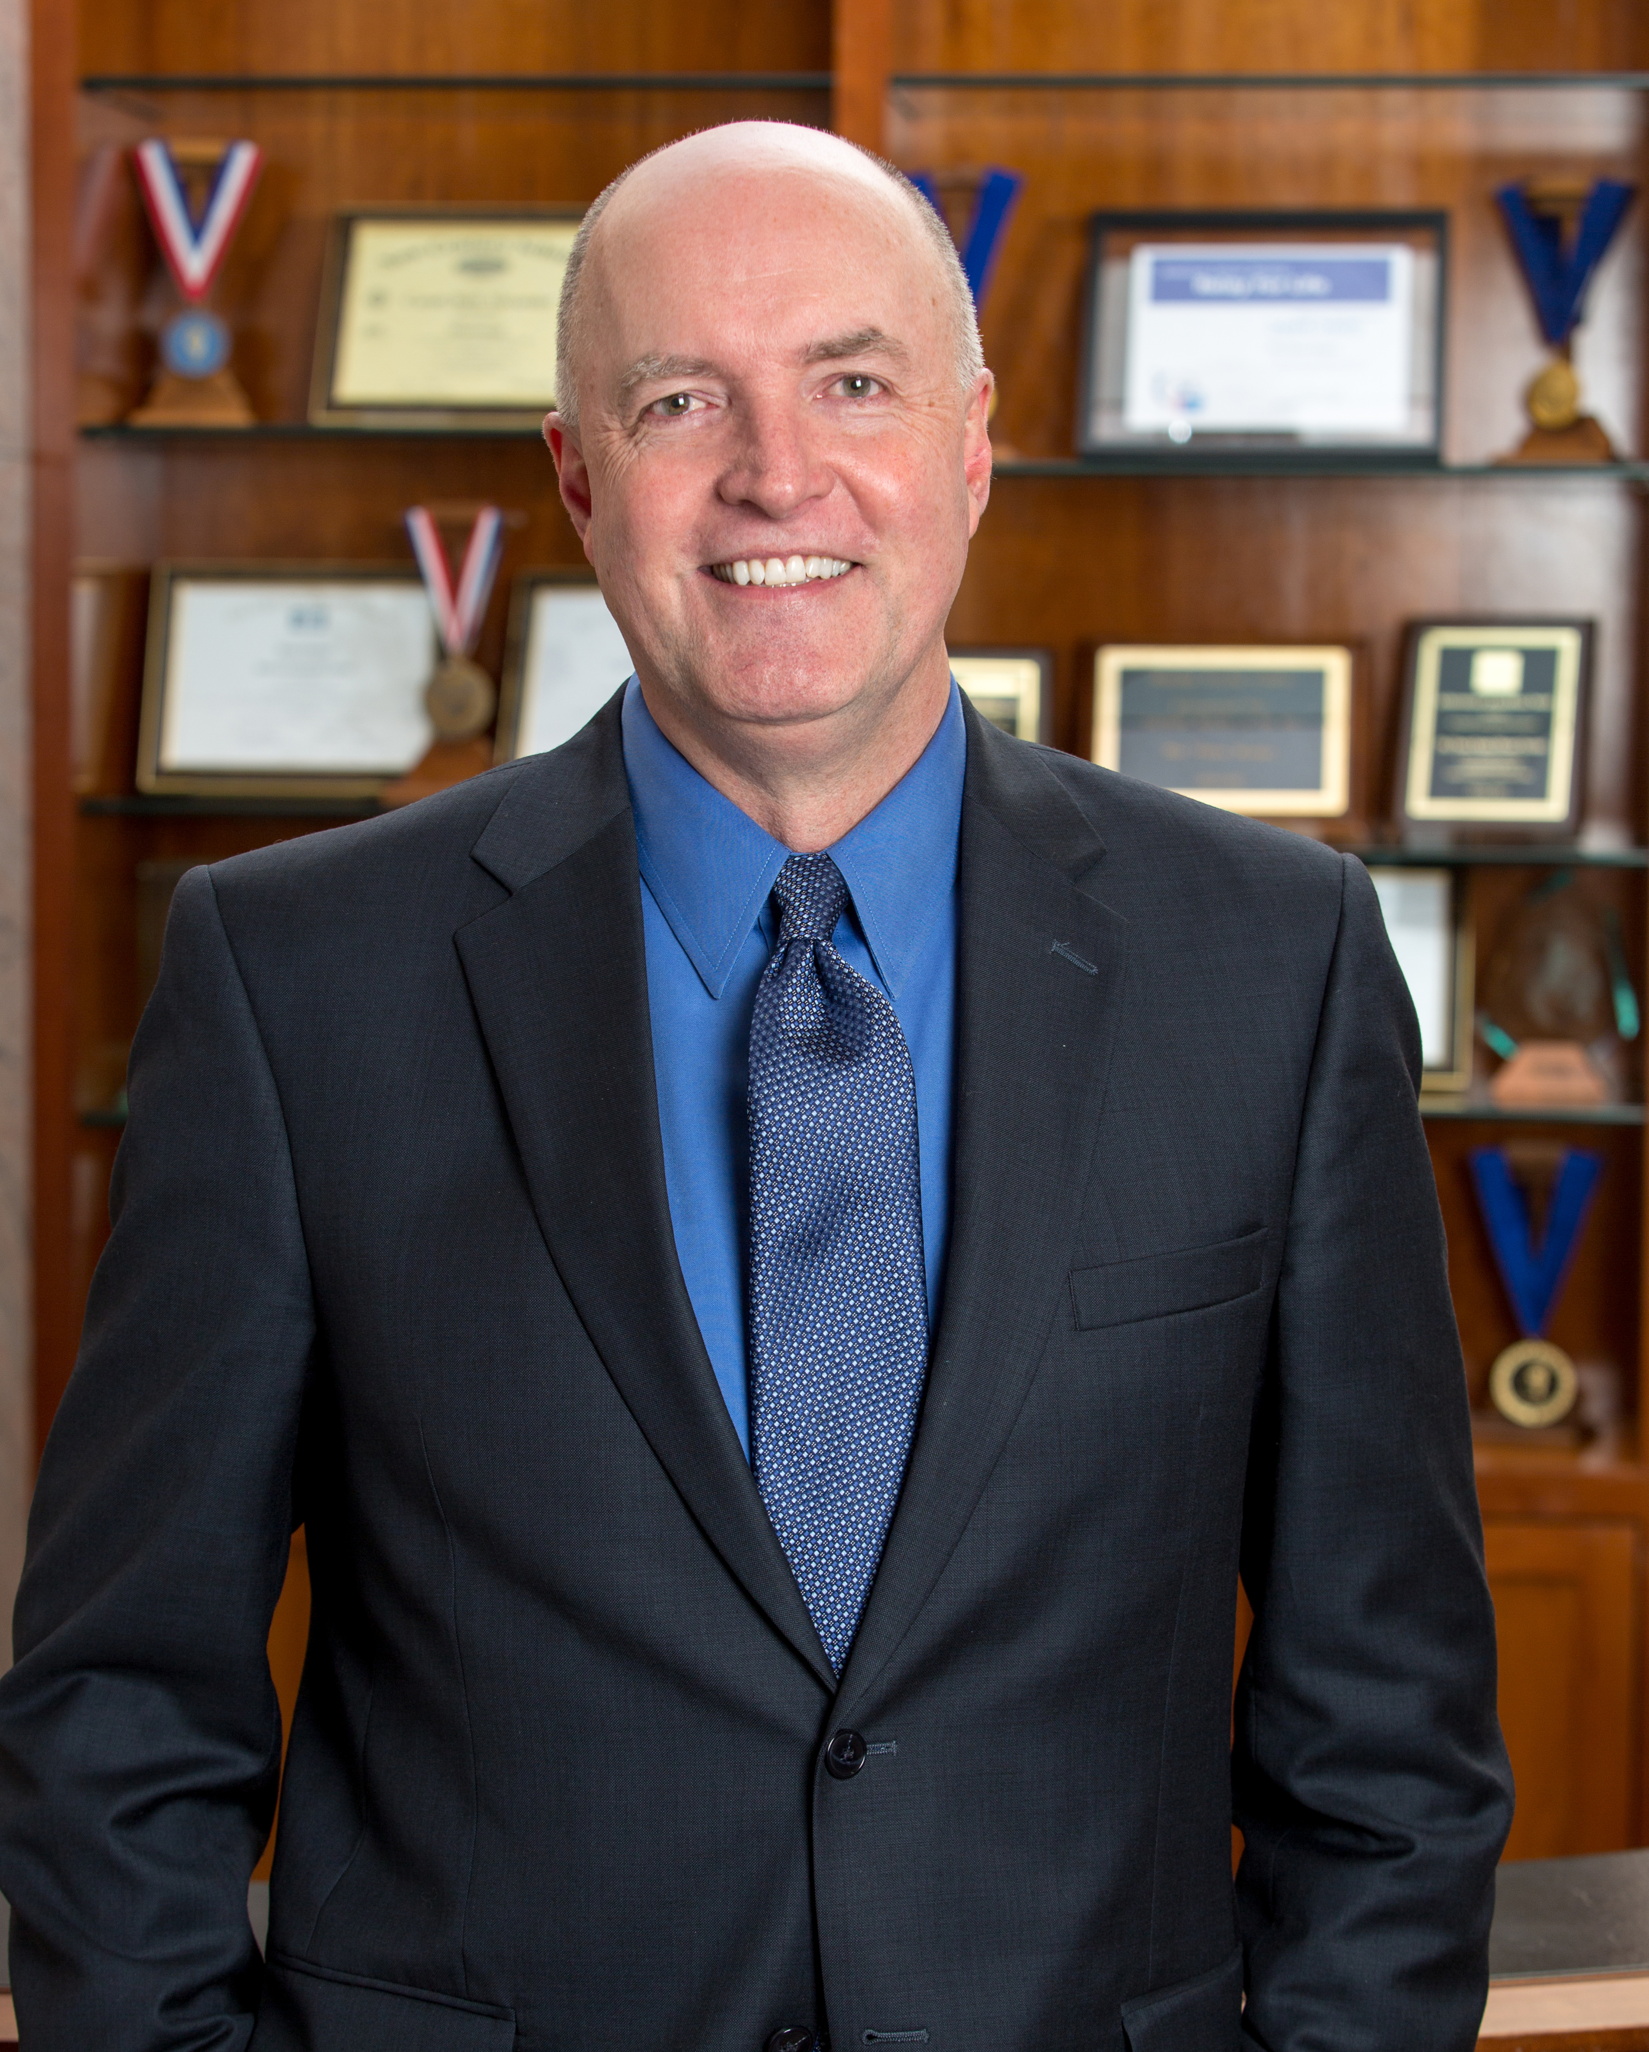
Advisors & Chapters Need College Support!
Dr. Dan Phelan President, Jackson College Jackson, Michigan
Member, Phi Theta Kappa Board of Directors
Notes:
It is essential to have allies in your college administration. Think about it… Having your dean or department director understand the extra time it takes to be an advisor while balancing your other responsibilities.
Navigating the financial paperwork needed for the chapter to travel to a conference. Or even organizing the meeting space, food & beverage and a myriad of other logistical details for a chapter induction. Having a supportive college administration who greases the wheels is invaluable. In this presentation, we take a look at a project designed to grow & strengthen that much-needed administrative support. It’s called a College Project.

Slide 3
Outstanding College Support for PTK
Providing release time/stipend for chapter advisor(s)
College official speaking at induction
Designing/printing induction program
Highlighting chapter’s achievements in college communications
Inviting chapter to speak at Faculty Convocations/Board of Trustees Meetings
Notes:
To further inspire your chapter to pursue a College Project, here are some additional ways chapters need their administration’s support or involvement

Slide 4
Outstanding College Support for PTK
6. Providing access to campus common areas/media outlets to promote PTK
7. Setting aside travel funds for PTK Conferences
8. Assisting with chapter fundraising
9. Establishing Membership Fee Scholarships
10. Advocating for PTK with community stakeholders
Notes:
You may easily be able to think of other ways besides these listed.

Slide 5
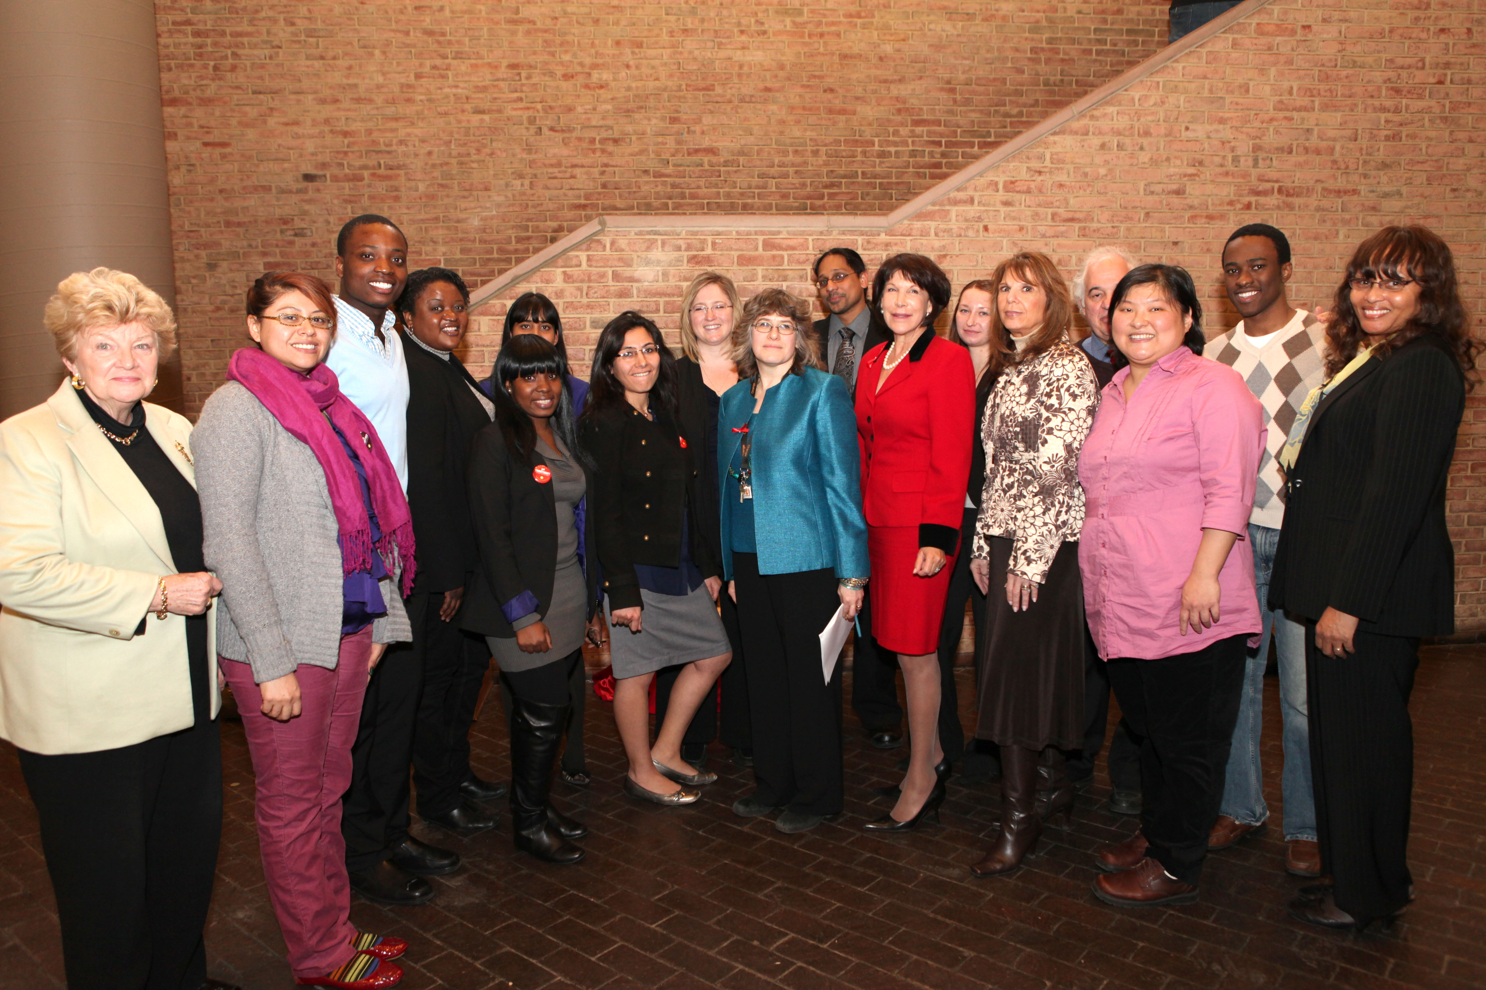
College Project Basics
Level 3 of Five Star Chapter Plan
Hallmark Award Category
Any project that directly supports college’s mission.
Strengthens relationship with college administration
Notes:
The College Project is found in Level 3 of the Five Star Chapter Plan. It is a once-a-year project that can be done anytime between January – December. Chapters may also submit a College Project entry in our Hallmark Awards Program. Entries are due in late January every year. Winners are announced at PTK Catalyst in April.
A College Project is any endeavor the chapter does in COLLABORATION with the college administration that directly supports the college’s mission.
In other words, it’s the chapter helping the administration meet their goals. It can be a big project, or a small one. The most important part is that it increases the communication and working relationship between the chapter and the college.

Slide 6
Communication & Collaboration
Chapter Meets with College President or Other Administrator
Communicates Throughout Project
Notes:
A key part of determining the College Project is for chapter members to meet with your college president not only to determine the goals for the College Project, but also to provide regular updates throughout the process.
We know that sometimes a chapter’s access to the college president may be limited, so working with another administrator is perfectly acceptable.
Having a conversation with a top administrator to discuss the college’s priorities and how the chapter can assist them is a clear demonstration to the college that the chapter is more than just another student organization. They are a true partner and resource.
Again, the College Project can be anything that relates directly to the college’s mission, and is approved by the college administration.

Slide 7
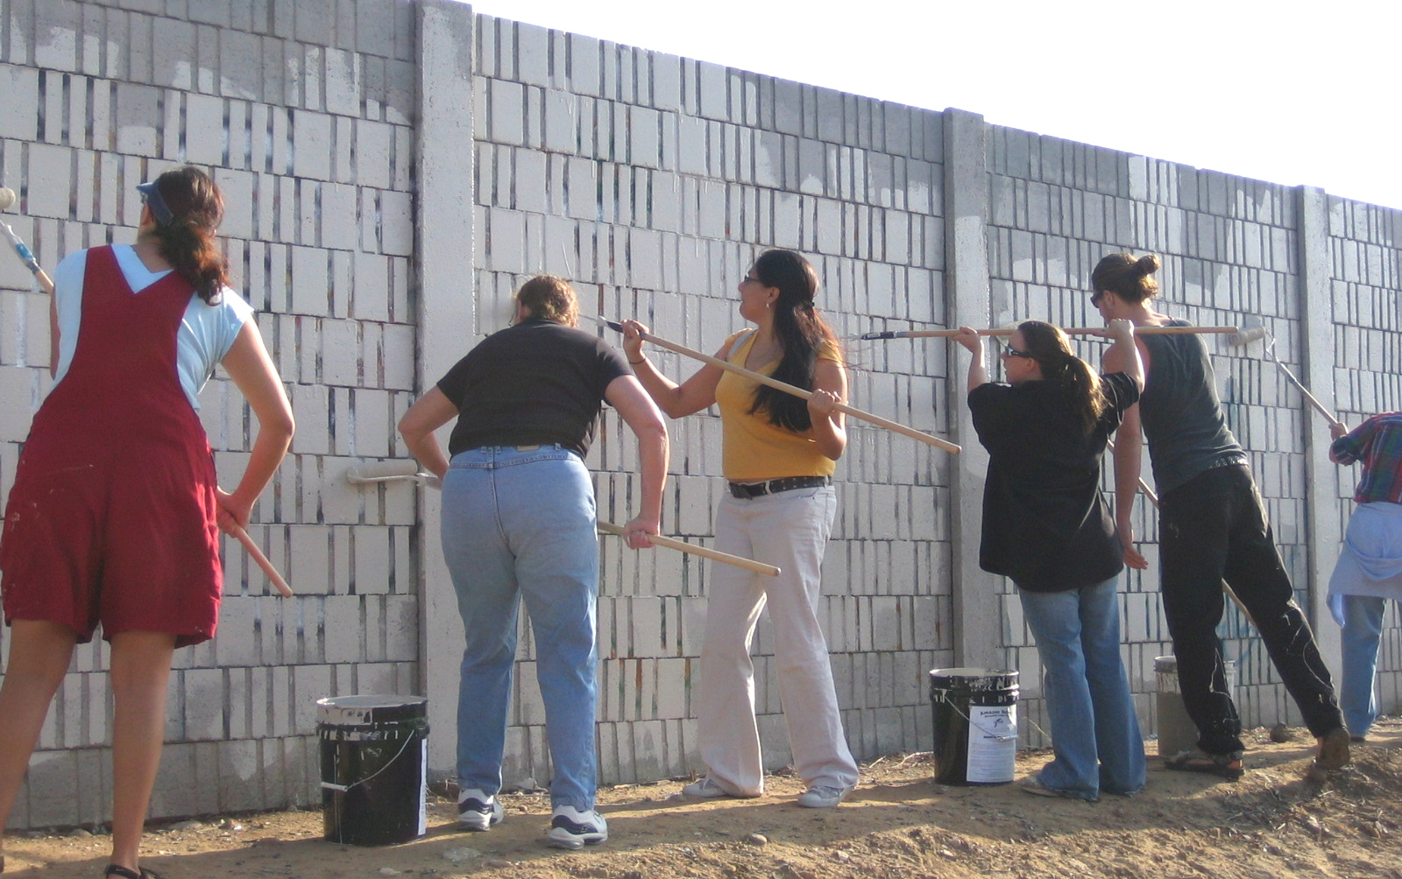
College Project Examples
Renovation of College’s Greenhouse & Garden
Hosting Relay For Life on Campus
Backpack to Briefcase: Connecting Recent Graduates to Community Jobs
Creating Campus Memorial to Pulse Nightclub Victims
Assisting in Development of a Freshman Orientation Course
Organizing a Campus “Mind & Body” Health Fair
Hosting Youth Leadership Development Program for Local High School Students
Notes:
Here are other examples of successful College Projects. As you can see, there are lots of different ways to approach a College Project. The College Project is PERSONALIZED for that particular college and their needs/goals at the moment. Notice that some of these projects serve to strengthen the sense of community on campus; others are specifically aimed at improving student retention. A project like Hosting a Youth Leadership Development Program allows the college to demonstrate its commitment to the community it serves while promoting itself as a college of choice to potential students.
Notice that some of these projects serve to strengthen the sense of community on campus such as the “Mind & Body” Health Fair; others are specifically aimed at improving student retention such as the development of a Freshmen Orientation Course. And with the Youth Leadership Development Program for local high school students as well as hosting a Relay For Life American Cancer Society fundraiser on campus, the college demonstrates its commitment to the community while promoting itself as a college of choice to potential students.
These are great public relations opportunities for the college.

Slide 8
College Project Entry Questions
Briefly describe your College Project and who from the chapter and the college administration was involved in determining it?
Summarize your objectives for the College Project and the process by which the chapter and college administration set these objectives.
Describe the planning process and strategies developed to complete the College Project.
What were the quantitative and qualitative outcomes of your project, including the lessons learned by your chapter members and others?

Slide 9
College Project Entries are judged on…
Preparation/Planning
Leadership Development
Cooperative Effort/Communications
Impact
Presentation
Notes:
As discussed earlier, the College Project can also be submitted for a Hallmark Award. http://www.ptk.org/Hallmarks Here are the 5 questions the chapter will answer about their College Project.

Slide 10
Preparation ~ 20 Points
8 points – Chapter made it a top priority to meet with appropriate administrator(s) to discuss College Project objectives before project was determined.
4 points – Clear, compelling evidence that the chapter leaders researched the college’s mission and/or strategic priorities prior to meeting with college administrators to determine project.
4 points – Strong evidence that the project was a JOINT decision between chapter and college. (Chapter did NOT implement their own project without input/approval from college.)
4 points -- The entry provides explicit details of how this project helps fulfill college’s mission/priorities.
Notes:
Next, we’ll review the TOP points in each rubric. For Preparation, judges are looking for a joint brainstorming session with Administration. Even if it cannot be with the Campus CEO/President, it should be with another high-level administrator. It’s OK if chapter has ideas to share, but there should be consensus WITH the administration on what project the chapter will do on its behalf.

Slide 11
Leadership Development ~ 20 Points
8 points – Substantive details provided of intentional teamwork between chapter and college officials. Details show members were strategic and thorough in organizing and implementing the project.
4 points - Clear evidence of intentional activities to improve members’ leadership skills. (What skills or abilities were necessary to carry out College Project and how did chapter members prepare themselves for these? (workshops, collaborating with experts, researching issue, etc.)
4 points – Compelling examples given with specific details of members fulfilling significant leadership roles in implementing the project.
4 points – Explicit details given of chapter’s most important planning steps to ensure successful project. Evidence shows members were strategic and thorough in organizing and implementing the project.
Notes:
Looking for specific ways the chapter members planned/prepared themselves for the implementation of the project… not just did the work. Yes, we learn by doing, but it’s important to prepare as much as possible. And that means seeking expert guidance or attending workshops or conferences that build the skills necessary to carry out the College Project. They can also talk about other leadership development activities they’ve done for other projects as long as they explain HOW it prepared them for THIS College Project.

Slide 12
Cooperative Effort/Communications ~ 20 Points
12 possible points - Strong evidence members communicated effectively and continuously with college administration/officials (details on how communication was carried out -- through advisor, through email updates, monthly meetings, follow-up with another administrator/department, etc.)
4 points - Before the project began to reach agreement on project goals/strategies
4 points - During the project (progress updates)
4 points - After the project was completed (results of project)
4 points – Strong evidence of chapter members’ flexibility and/or creativity in addressing any opportunities, challenges or obstacles in implementing project
4 points – Specific details provided of chapter seeking college’s input in addressing any opportunities, challenges or obstacles in implementing the project
Notes:
Since strengthening the relationship with the college administration is Primary Focus of a successful College Project, communication and cooperative effort needs to be clearly articulated. It is perfectly acceptable that the chapter may work with other faculty, administrators or staff to complete a project, but there should also be a communication plan for updating the campus CEO/top administrator. AND if a chapter runs into obstacles, they should make sure they brainstorm with appropriate administrators/staff to make necessary revisions to the College Project.

Slide 13
Impact ~ 20 Points
4 points – Clear, compelling evidence of project’s outcomes through quantitative data. (Examples could be amount of scholarship created, money donated, number of people reached through a project, number of audience members at an event, etc.)
4 points – Clear, compelling evidence of project’s outcomes through qualitative data. (intangible benefits/outcomes that can be through meaningful interactions such as survey comments, reactions by those who benefited from a project, description of how project filled a need/wish list item, personal growth experienced by participants, etc.)
4 points – Clearly articulated how these outcomes addressed the college’s goals for the project
4 points – Clearly articulated how chapter’s relationship with college was strengthened
4 points – Details provided meaningful reflection of how chapter members grew in knowledge and as scholar-servant-leaders throughout the project
Notes:
Make sure the project planning includes a way to assess impact. The project needs to have a measurable component by which its success is measured, but also garner ways that the chapter members and the targeted audience for the project grew personally as well. Knowing the project will likely only have a few months from start to finish, realistic goals must be set.

Slide 14
Presentation ~ 5 Points
5 points - Spelling and grammar are faultless.
3 points - A few errors in spelling and/or grammar.
1 point - Spelling and/or grammar errors throughout.

Slide 15
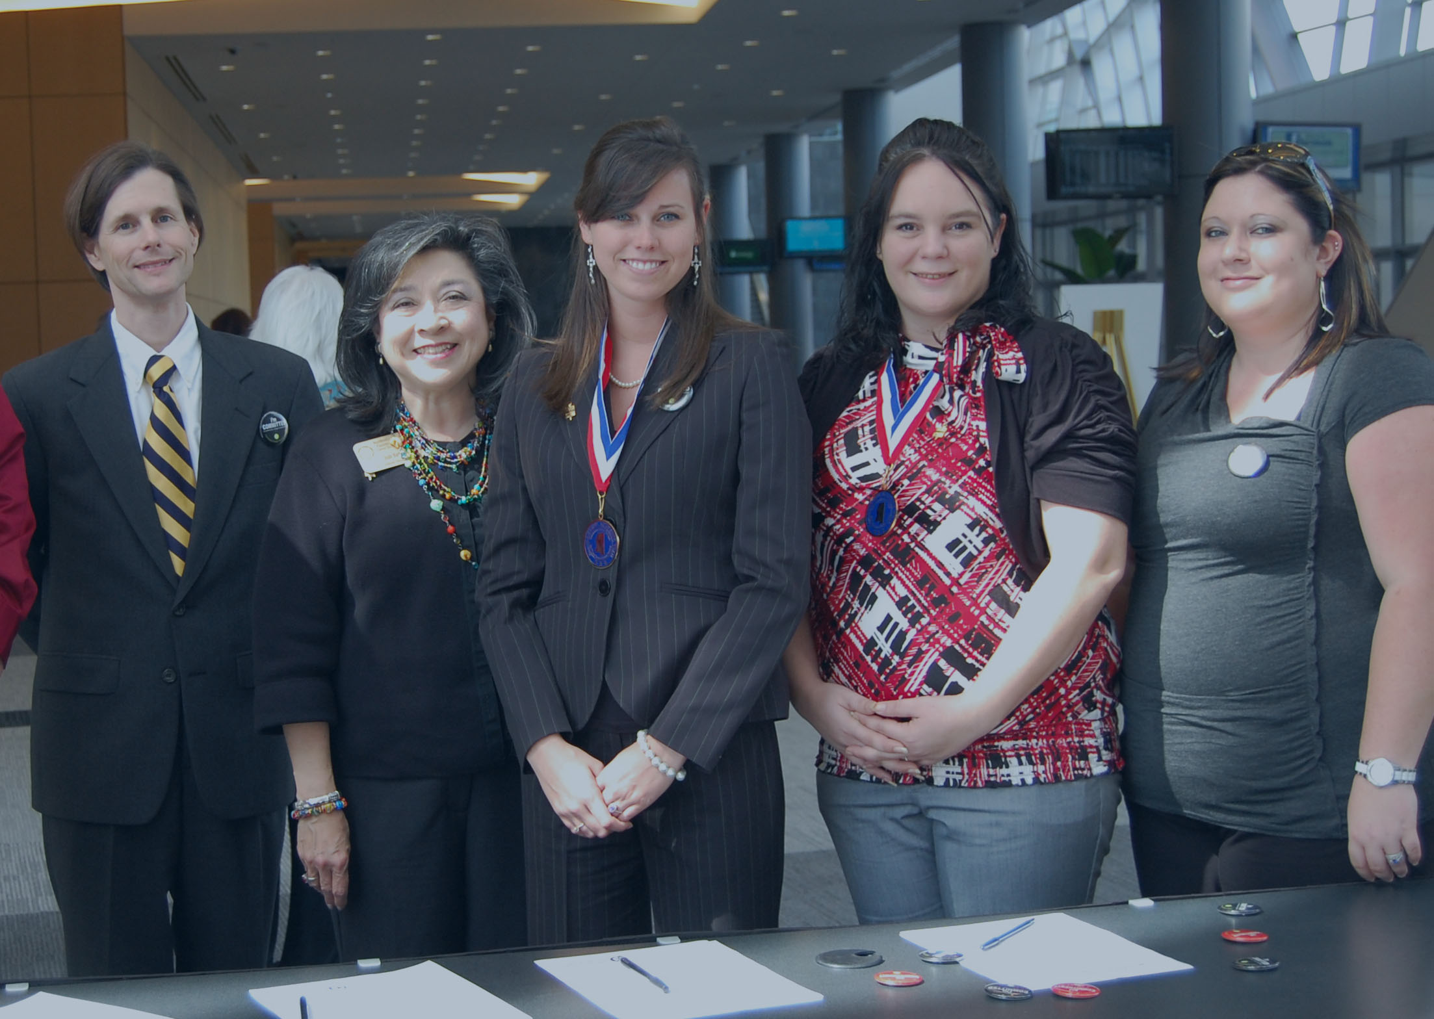
Jennifer.Stanford@ptk.org 601-984-3532
Questions?

